Slide 1
Attributes
Associating declarative information with C# code
Programming – Introduction to C#
Last modified 12/12/16 by Alex Mackay

Slide 2
Contents
About Attributes
Pre-defined Attributes
Developing Custom Attributes
Controlling Attribute Usage
Parameters
Querying at Runtime
Attributes and Windows Forms

Slide 3
About Attributes
For defining declarative tags
metadata
Can be placed on source code entities
Assemblies, Modules, Classes, etc
Attribute information retrieved at runtime via reflection
Can use pre-defined attributes, or define custom ones

Slide 4
Pre-defined Attributes
The Obsolete attribute marks an entity that shouldn’t be used
true indicates error at compile time
About 200 or so pre-defined attributes
https://msdn.microsoft.com/en-us/library/2e39z096.aspx
using System;
public class AnyClass
{
[Obsolete("Don't use Old method, use New method", true)]
static void Old( ) { }
static void New( ) { }
public static void Main( )
{
Old( );
}
}
AnyClass.Old()' is obsolete: 'Don't use Old method, use New method'

Slide 5
Developing Custom Attributes
Derive (directly or indirectly) from System.Attribute
The Attribute suffix is a naming convention
When using the attribute we can drop the suffix
public class HelpAttribute : Attribute
{
}
[Help()]
class ClassWithAttributes
{
}

Slide 6
Developing Custom Attributes
Properties can be queried at run time
public class HelpAttribute : Attribute
{
public HelpAttribute(String description) {
this.description = description;
}
protected String description;
public String Description {
get {
return this.description;
}
}
}
[Help("This class does nothing")]
class ClassWithAttributes
{
}

Slide 7
Controlling Attribute Usage
AttributeUsage controls where our custom attribute can be placed
Contains 3 properties
ValidOn:
which entities can use the attribute
AllowMultiple:
can the attribute be placed on an entity more than once
Inherited:
is the attribute inherited by derived classes
[AttributeUsage(AttributeTargets.Class,
AllowMultiple=false,
Inherited=false)]
public class HelpAttribute : Attribute
{
public HelpAttribute(String description) {
this.description = description;
}
protected String description;
public String Description {
get {
return this.description;
}
}
}

Slide 8
AttributeUsage - ValidOn
AttributeTarget.Class specifies only valid on classes
Otherwise produces error
Possible values for the attribute target:
[AttributeUsage(AttributeTargets.Class, AllowMultiple=false, Inherited=false)]
public class HelpAttribute : Attribute { }
ClassWithAttributes.cs: Attribute 'Help' is not valid on this declaration type. It is valid on 'class' declarations only.
Assembly, Module, Class, Struct, Enum, Constructor, Method, Property, Field, Event, Interface, Parameter, Delegate,
All (Assembly | Module | Class | Struct | Enum | Constructor | Method | Property | Field | Event | Interface | Parameter | Delegate),
ClassMembers (Class | Struct | Enum | Constructor | Method | Property | Field | Event | Delegate | Interface)

Slide 9
AttributeUsage - AllowMultiple
Specifies if an attribute can be placed on an entity can more than once
using System;
[Help("This class does nothing")]
[Help("it contains a do-nothing method")]
public class ClassWithAttributes
{
}
ClassWithAttributes.cs: Duplicate 'Help' attribute

Slide 10
AttributeUsage - Inherited
[AttributeUsage(AttributeTargets.Class, AllowMultiple = false, Inherited = false] Querying a derived class will not find the attribute
[AttributeUsage(AttributeTargets.Class, AllowMultiple = true, Inherited = false] Querying a derived class will not find the attribute
[Help("BaseClass")]
public class Base
{
}
public class Derive : Base
{
}

Slide 11
AttributeUsage - Inherited
[AttributeUsage(AttributeTargets.Class, AllowMultiple = false, Inherited = true] Gets the derived class attribute only, as allow multiples is false. Base class attribute overridden by derived class
[AttributeUsage(AttributeTargets.Class, AllowMultiple = true, Inherited = true ] Get both attributes
[Help("BaseClass")]
public class Base
{
}
[Help("DeriveClass")]
public class Derive : Base
{
}

Slide 12
Parameters
public class HelpAttribute : Attribute
{
public HelpAttribute(String description) {
this.description = description;
this.verion = "undefined";
}
protected String description;
public String Description {
get {
return this.description;
}
set
{
description = value;
}
}
protected String version;
public String Version {
get {
return this.version;
}
set {
this.version = value;
}
}
}
Parameters in the Attribute class constructor are mandatory
Named parameters are optional and are not parameters of the constructor
Don’t use multiple constructors for optional parameters
Mark them as named parameters
[Help("This class does nothing", Version = "1.0")]
class ClassWithAttributes
{
}

Slide 13
Querying at Runtime
Query attributes at run time via reflection
To get the attributes of a class, get the Type
Use the typeof() operator
Get all attributes by calling GetCustomAttributes
Pass in true to search inheritance chain
Similar process to get attributes on methods, fields, etc

Slide 14
Querying at Runtime
static void Main(string[] args)
{
Type type = typeof(ClassWithAttributes);
HelpAttribute HelpAttr;
//Querying Class Attributes
foreach (Attribute attr in type.GetCustomAttributes(true)) {
HelpAttr = attr as HelpAttribute;
if (null != HelpAttr) {
Console.WriteLine("Description of ClassWithAttributes - (Version: {0}) :\n {1}",
HelpAttr.Version, HelpAttr.Description);
}
}
//Querying Class-Method Attributes
foreach (MethodInfo method in type.GetMethods()) {
foreach (Attribute attr in method.GetCustomAttributes(true)) {
HelpAttr = attr as HelpAttribute;
if (null != HelpAttr) {
Console.WriteLine("Description of {0} - (Version: {1}) :\n {2}",
method.Name, HelpAttr.Version, HelpAttr.Description);
}
}
}
}
Notes:
Full program in sample 1 folder

Slide 15
Attributes and Windows Forms
.NET Framework provides attributes you can apply to members of your custom controls
Can affect either run-time or design-time behavior
The Windows Forms designer uses attributes extensively

Slide 16
Attributes on Custom Controls
Using the custom clock control from the Win Forms lesson:
CategoryAttribute: name of the category to group the property / event
DescriptionAttribute: Specifies a description for a property/event
DefaultValueAttribute: Specifies the default value for a property
Complete list: https://msdn.microsoft.com/en-us/library/vstudio/ms171724(v=vs.100).aspx
public class FirstControl:System.Windows.Forms.Control
{
private bool showSeconds = true;
[
Category("Show Seconds"),
Description("Show the second hand."),
DefaultValue(true)
]
public bool ShowSeconds
{
get
{
return showSeconds;
}
set
{
showSeconds = value;
Invalidate();
}
}
...
}

Slide 17
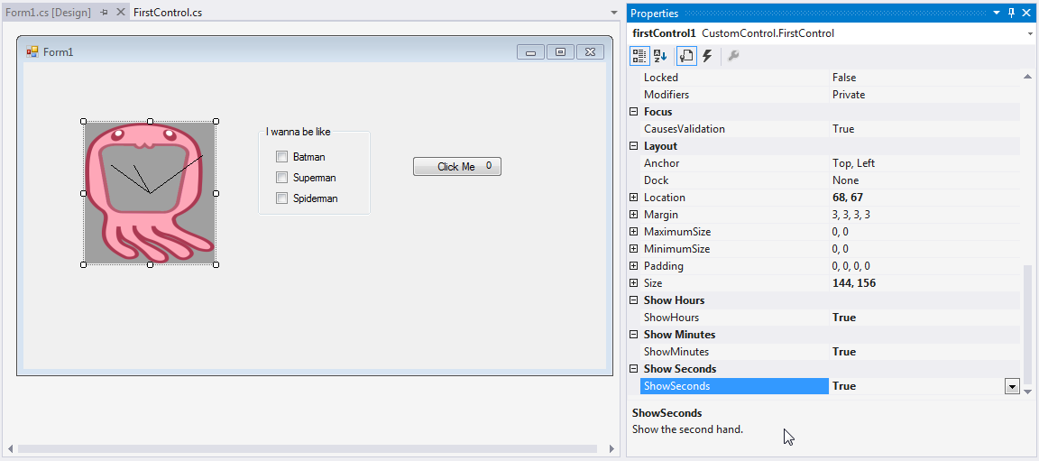
Attributes on Custom Controls

Slide 18
Summary
Attributes proved a mechanism for defining additional information about entities in our program
A set of pre-defined attributes exist, or we can create our own
Use reflection to query these attributes at run time
Add attributes to custom controls to specify run-time or design-time behaviour

Slide 19
Further Reading
Sadaf Alvi. 2002. Attributes in C#. [ONLINE] Available at: http://www.codeproject.com/Articles/2933/Attributes-in-C. [Accessed 12 December 16]
Microsoft. 2016. Attribute Hierarchy. [ONLINE] Available at: https://msdn.microsoft.com/en-us/library/2e39z096.aspx. [Accessed 12 December 16]
Microsoft. 2016. Attributes in Windows Forms Controls. [ONLINE] Available at: https://msdn.microsoft.com/en-us/library/vstudio/ms171724(v=vs.100).aspx. [Accessed 12 December 16]

